Slide 1

Advanced Software Engineering Mid-term Presentation
HARSHA JALLURI
Satya Sree varsha pONNAGANTI

Slide 2
Outline
1. Introduction – Motivation
2. Dataset
3. Research Questions
4. Methodology
5. Outputs

Slide 3
Motivation
Software Vulnerability – A threat
Cybersecurity Attacks
Requirement of Software Assurance Codes
1. Known Bugs
2. Their associated fixes

Slide 4
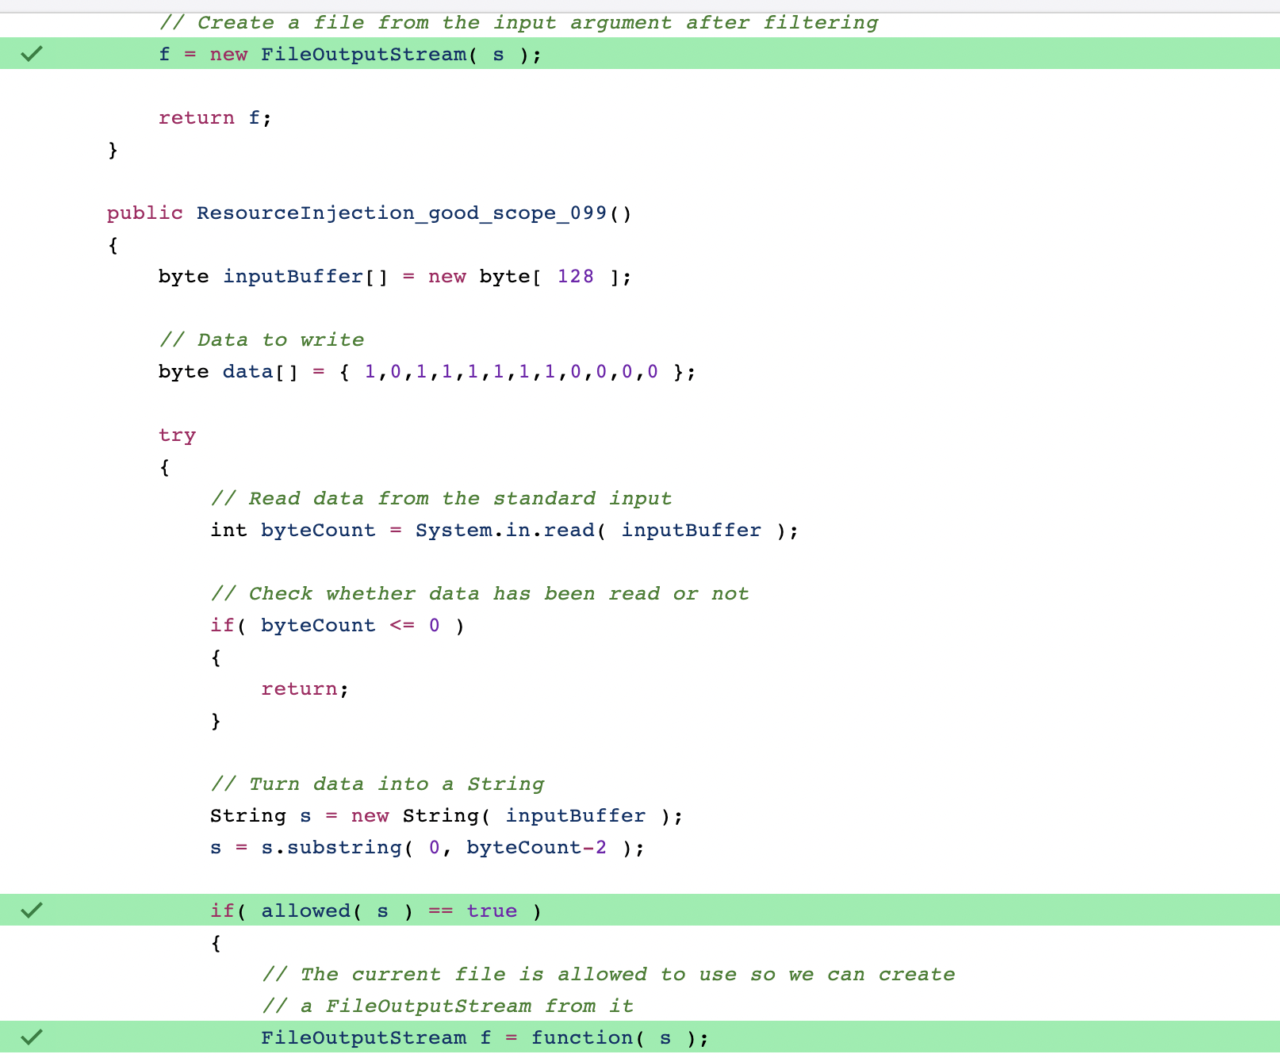
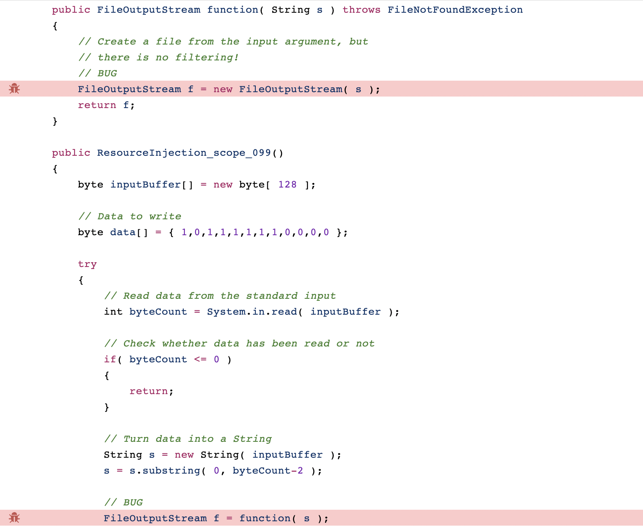
Dataset - SARD
Software Assurance Reference Dataset

Slide 5
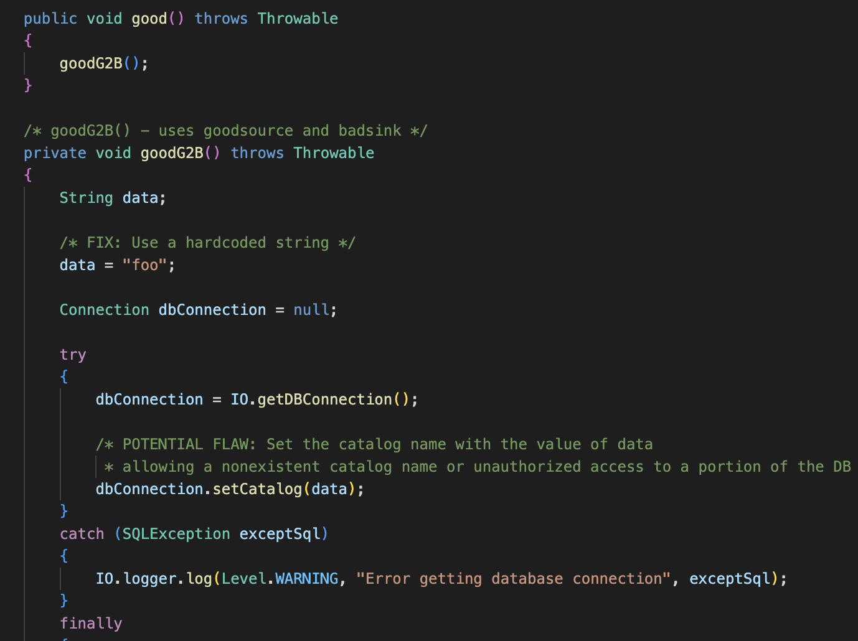
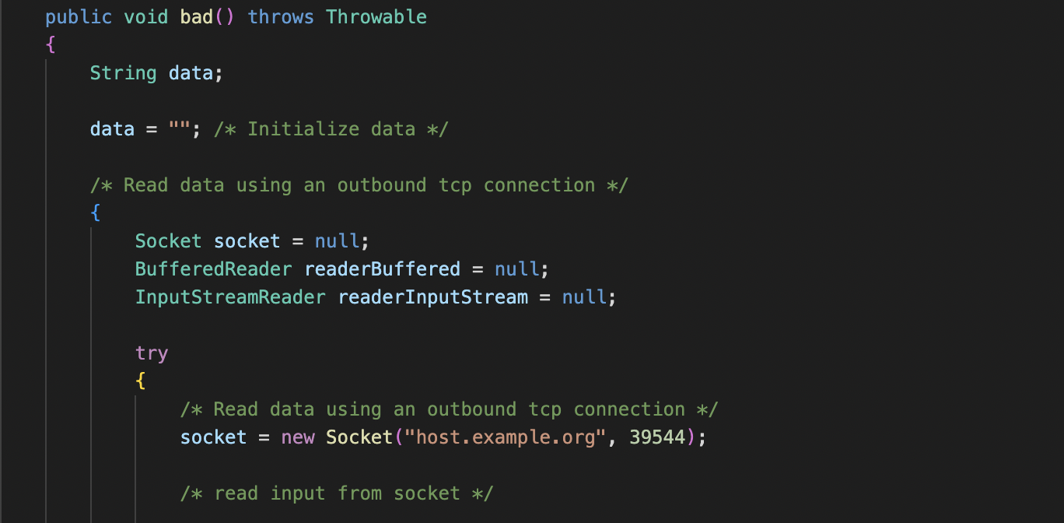
Dataset – original
One java class contains both good and bad functions
Extracted the methods using srcML
Further divided good and bad functions separately

Slide 6
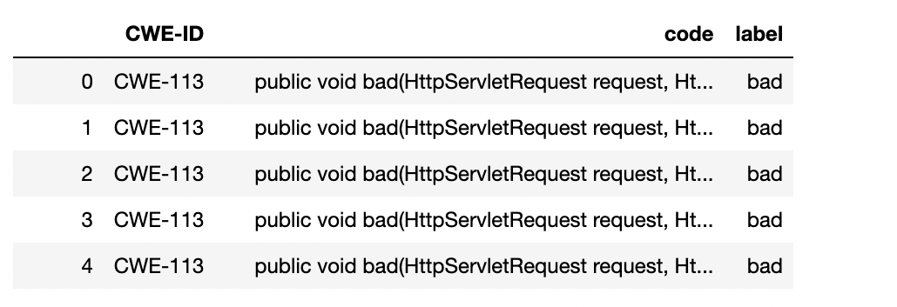
Dataset - attributes
CWE (Common Weak Enumeration) ID
Code
Label - Bad/Good

Slide 7
Research Question
1. Is Semantic information enough to predict Good and Bad codes?
2. Can we classify CWE Categories from semantic information?

Slide 8
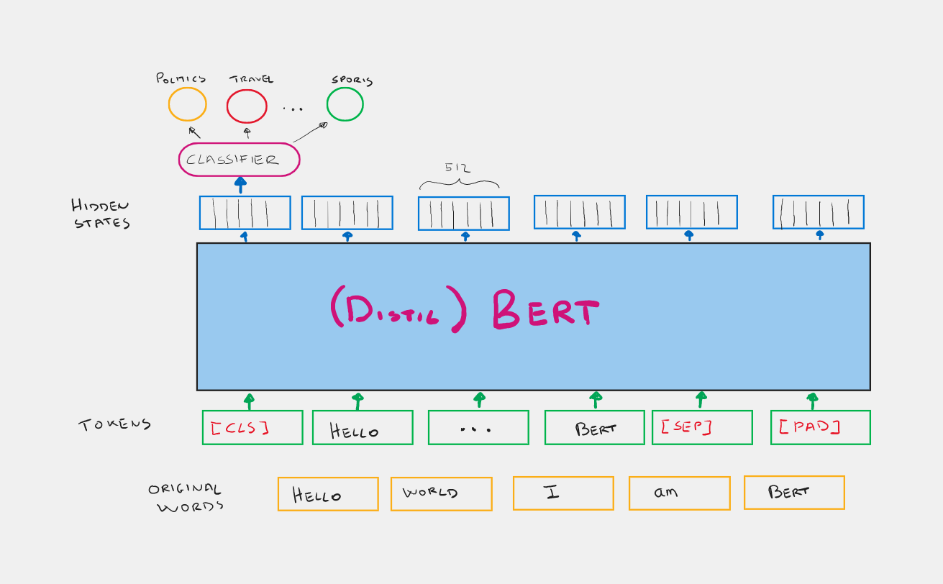
RQ -1 Model
Sentence BERT
383
SENTENCE BERT
Transformer

Slide 9
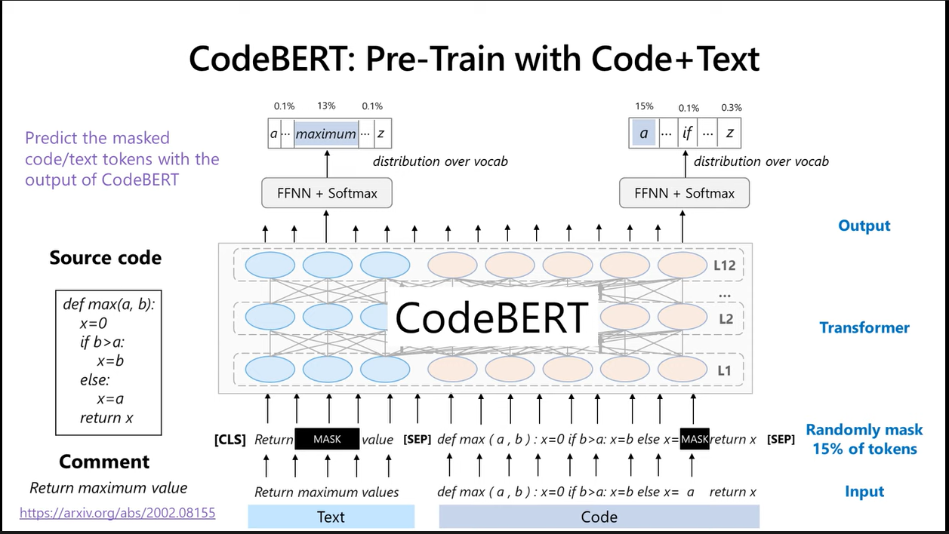
Model -2

Slide 10
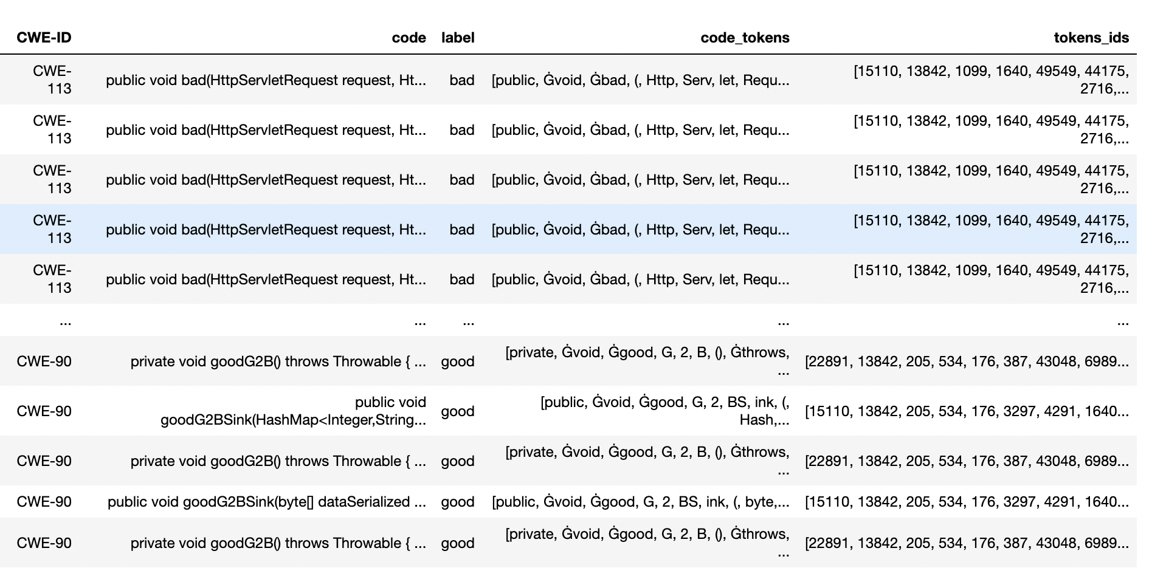
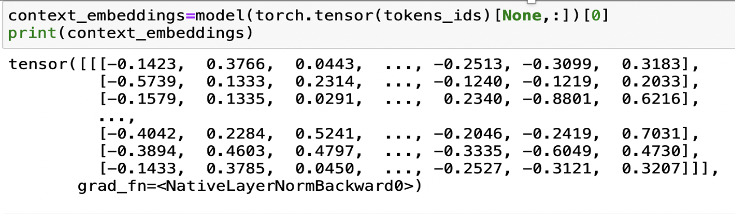
Working with CodeBERT

Slide 11
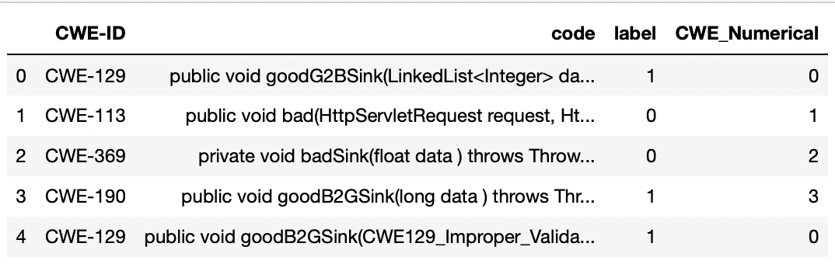
Pre-Processing Data
Convert CWE-ID and Label columns to Numerical values

Slide 12
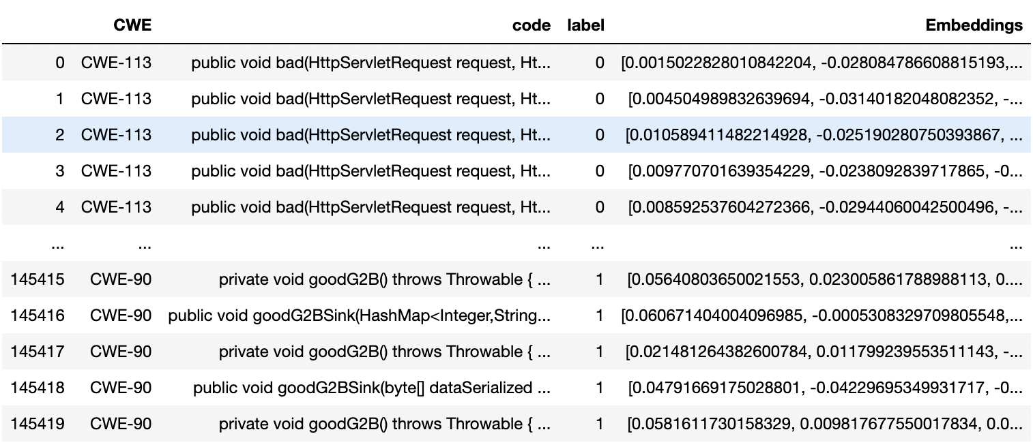
Ground Truth
Independent Variables:
Embeddings
Target Variables:
Label – Bad/Good
CWE - ID

Slide 13
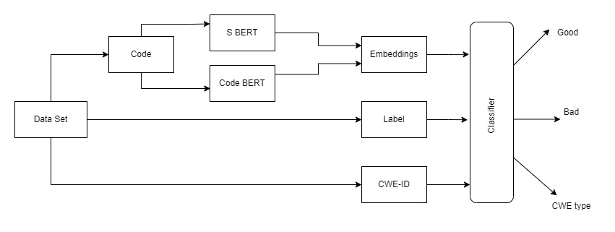
Proposed Model

Slide 14
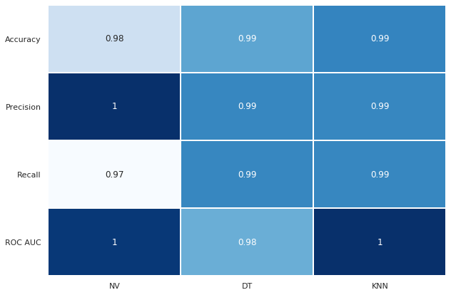
Results – RQ 1
SBERT Embeddings for predicting
Bad and Good Codes
Classification Algorithms:
NV – Naïve Bayes
DT – Decision Trees
KNN – KNearest Neighbours
RF - Random Forest

Slide 15
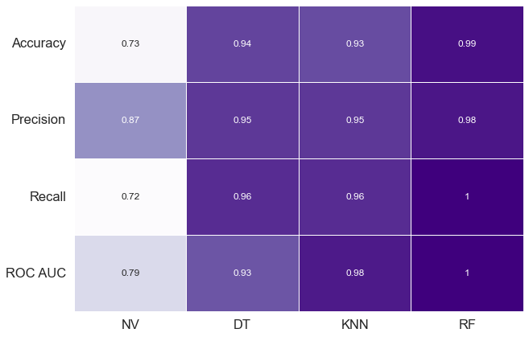
Results (cont.) RQ 1
CodeBERT Embeddings for predicting
Bad and Good Codes

Slide 16
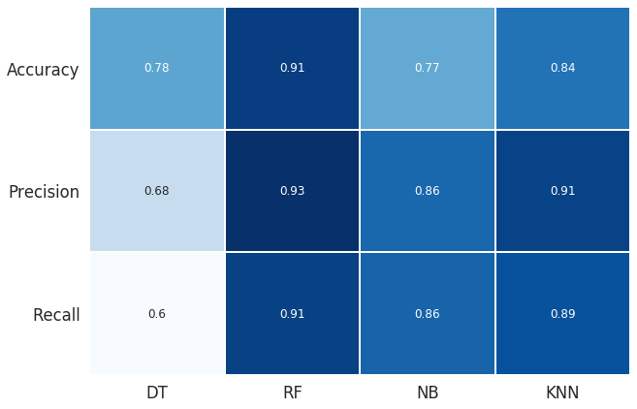
RQ – 2 Results
SBERT Embeddings for predicting
CWE Categories

Slide 17
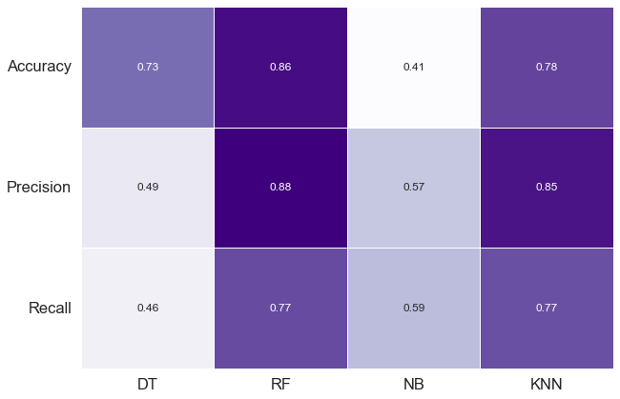
Results (cont.) RQ 2
CodeBERT Embeddings for predicting
CWE Categories

Slide 18
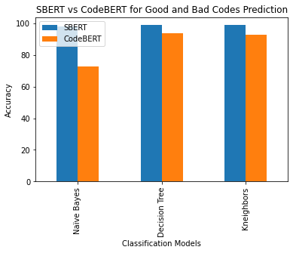
Comparison - 1

Slide 19
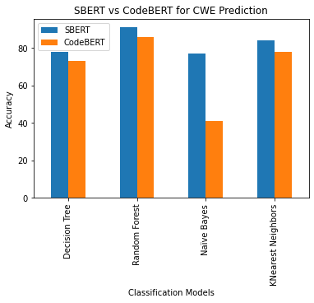
Comparison - 2

